Slide 1
Sequential Patterns

Slide 2
Sequential patterns and text mining
Text data are naturally represented as sequences
Item = word or character
Sequential pattern = phrases, collocations, or expressions

Slide 3
Extracting N-grams and Skip-grams in text
N-gram examples
Skip-gram examples
“Ann Arbor”
“hot dog”
“in front of”
“Txt U L8R”
“not only … but also”
“deep * networks”

Slide 4
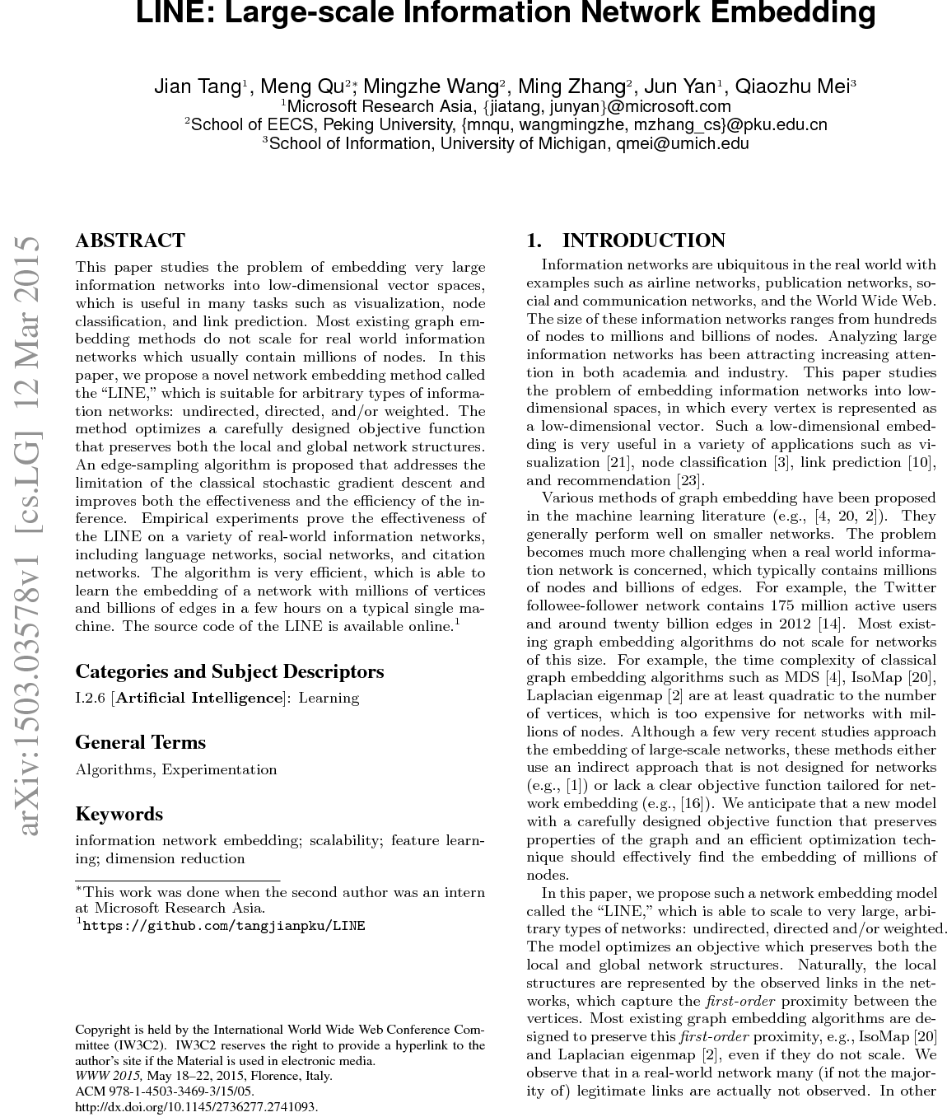
Use sequential patterns for text mining
sequence of words
n-grams and skip-grams
w₁ → w₂ → … → w_{k}
w₁w₂, w₂w₃, w₁w₃w₅, ...
Classification
Clustering
Ranking
Recommendation
Visualization
...
Modeled as itemsets or feature vectors

Slide 5
Example of sequential patterns for text mining
“to be or not to be”
Represented as set of trigrams:
{“to be or”, “be or not”, “or not to”, “not to be”}
Represented as a vector of bigrams:
Dimensions = {“to be”, “be or”, “or not”, “not to”}
Vector = ⟨2, 1, 1, 1⟩
Then all functionalities for itemsets/vectors can be applied

Slide 6
What you should know
Difference between sequential patterns and frequent itemsets
n-grams and skip-grams
How to represent text data as sets/vectors of n-grams and skip-grams

Slide 7


School of Information, University of Michigan
Qiaozhu Mei
School of Information
All Content © Presenter

